Slide 1
Insurance Project for HLF1
By
Dinesh Selvam
Milan Harris

Slide 2
Project Details
Goals:
Create a Hyper ledger Fabric network between 2 or more Organizations with Client Applications to simulate a partnership network of Insurance Organizations
Functionality:
Organizations will be able to:
Create a Account for each new User and also allow additional users to be linked to account. Simulates user relations ( Self, Spouse, Dependents )
Create Insurance Plans which Users will be able to view and register ( Gold, Silver, Bronze )
Create Insurance Policy which can be added to plans ( Medical, Vision, Dental )

Slide 3
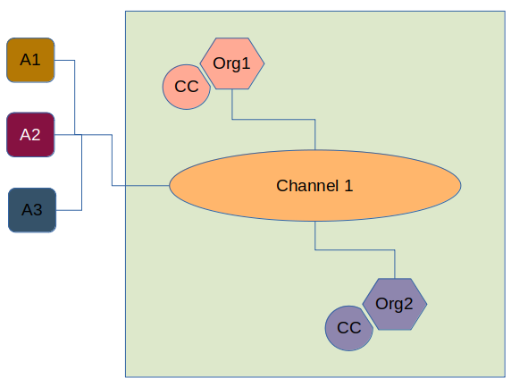
Network Setup
Organization 1 and 2 deploys chain code and is part of Channel 1.
Client Applications ( web or other, represented by A1, A2, A3) is also connected to the Channel to access information.

